Slide 1


c. 600 CE- c. 1450
By: Jess Waldeyer, Julianna DeGenova, Cassidy Turnbach, Tomas Beaton

Slide 2

Rise of Islam (632 CE)
Islam claimed prophets from both Judaism and Christianity.
Spread through conquest and expansion of the Muslim state, bringing its culture throughout the Middle East.
Because of its variety of motives, the religion turned Islamic and Arab communities into fast-growing religious and political identities.
Theme: Development and interaction of cultures

Slide 3
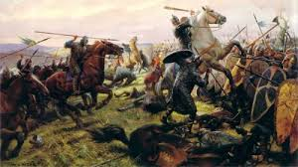
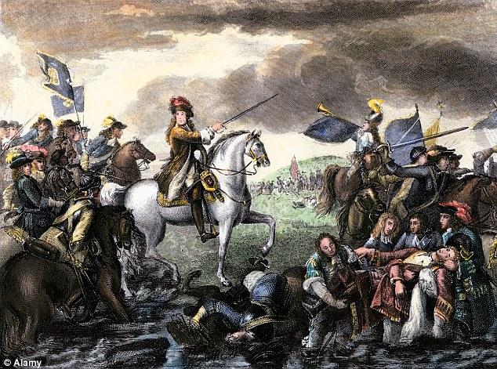
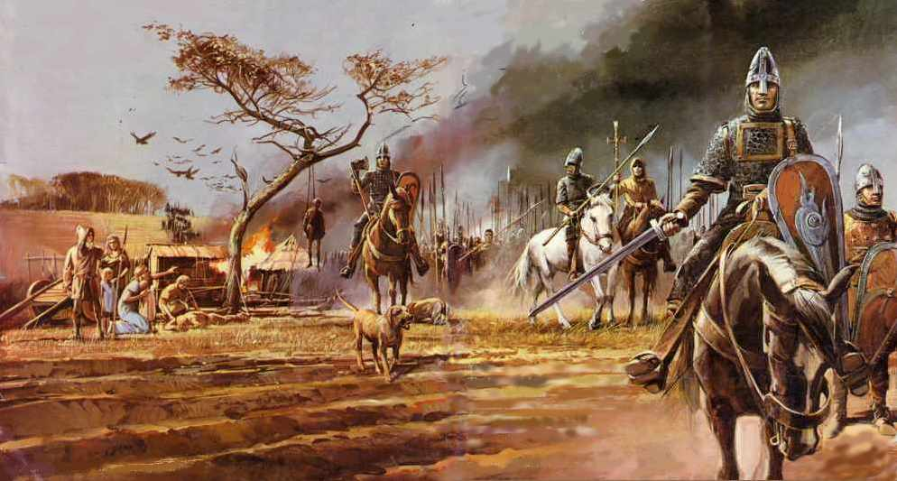
Norman Conquest of England (1066)
This “conquest” was an invasion of England led by William I, Duke of Normandy.
When Edward the Confessor, the former king of England, died William I claimed that Edward had promised him that he could be the heir to the throne and that the crown of England was rightfully his.
The true successor was originally Harold II. William of Normandy brought his army across the English Channel and defeated and killed Harold II, claiming the crown for himself, all while defying English leader’s repeatedly in doing so.
This connects with AP World theme #3, State-building and forms of government, specifically: revolts and revolutions.
This is because William I rose up against authority and embraced rebelling against the English leaders and rightful King of England.
William of Normandy revolted against the government and conquered England all in one.

Slide 4
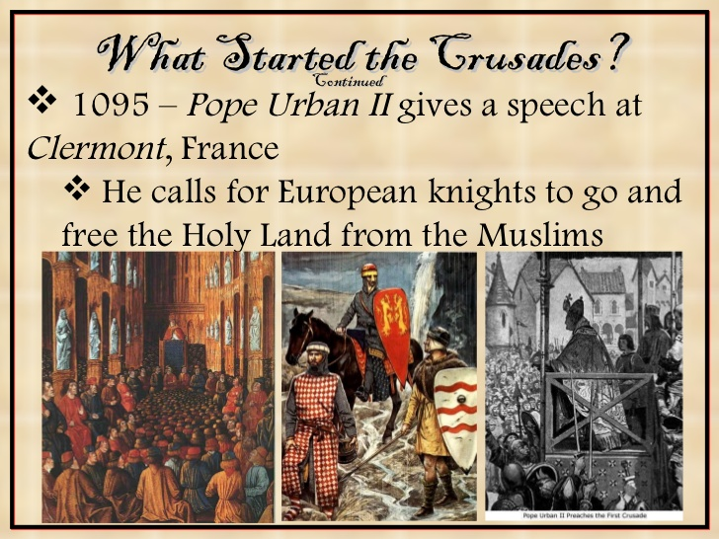
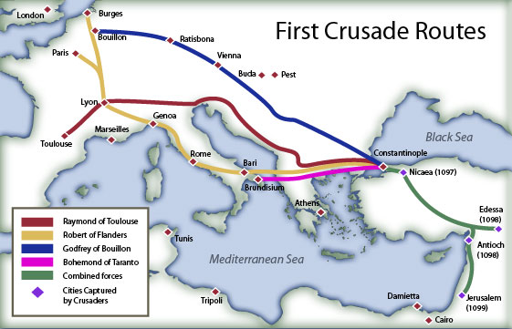
First Crusade (1095-1099)
The First Crusade was a war waged by Christian Knights against the Muslims in Jerusalem in an attempt to reclaim the Holy Land.
The crusades were called by Pope Urban II and begun in western Christendom and ended as a military expedition by Roman Catholic Europe.
During the crusade, knights, serfs, and peasants from various regions of western Europe traveled over land and by sea in order to reach Jerusalem.
It connects to AP World Theme #3, state buildings and forms of government; specifically with revolts and revolutions.
The first crusade ultimately ended in the capture of Jerusalem by the Christian Knights in 1099.

Slide 5
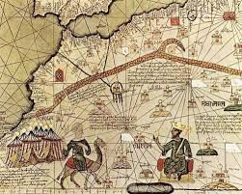
Mansa Musa’s Pilgrimage (1324)
Mansa Musa served as the King of Mali in Western Africa.
His empire controlled the gold and salt trades of Africa.
He took a pilgrimage to Mecca, the Muslim holy city.
He traveled with an incredible amount of gold and subjects.
Musa ran out of money due to his spending and generosity to foreigners and peoples in Cairo and Mecca.
He left so much gold in Egypt that it eventually depressed the value of gold for over a decade.
When he came back with Arab Scholars he introduced advanced building techniques to Mali.
His pilgrimage relates to AP World theme #3, State-building and forms of government, specifically empires.This is because much of Mali’s success as an empire can be credited to Musa. Also Musa’s main focus was to improve his country and empire peacefully and in doing so Musa was politically and morally inclined for the sake of his country.

Slide 6
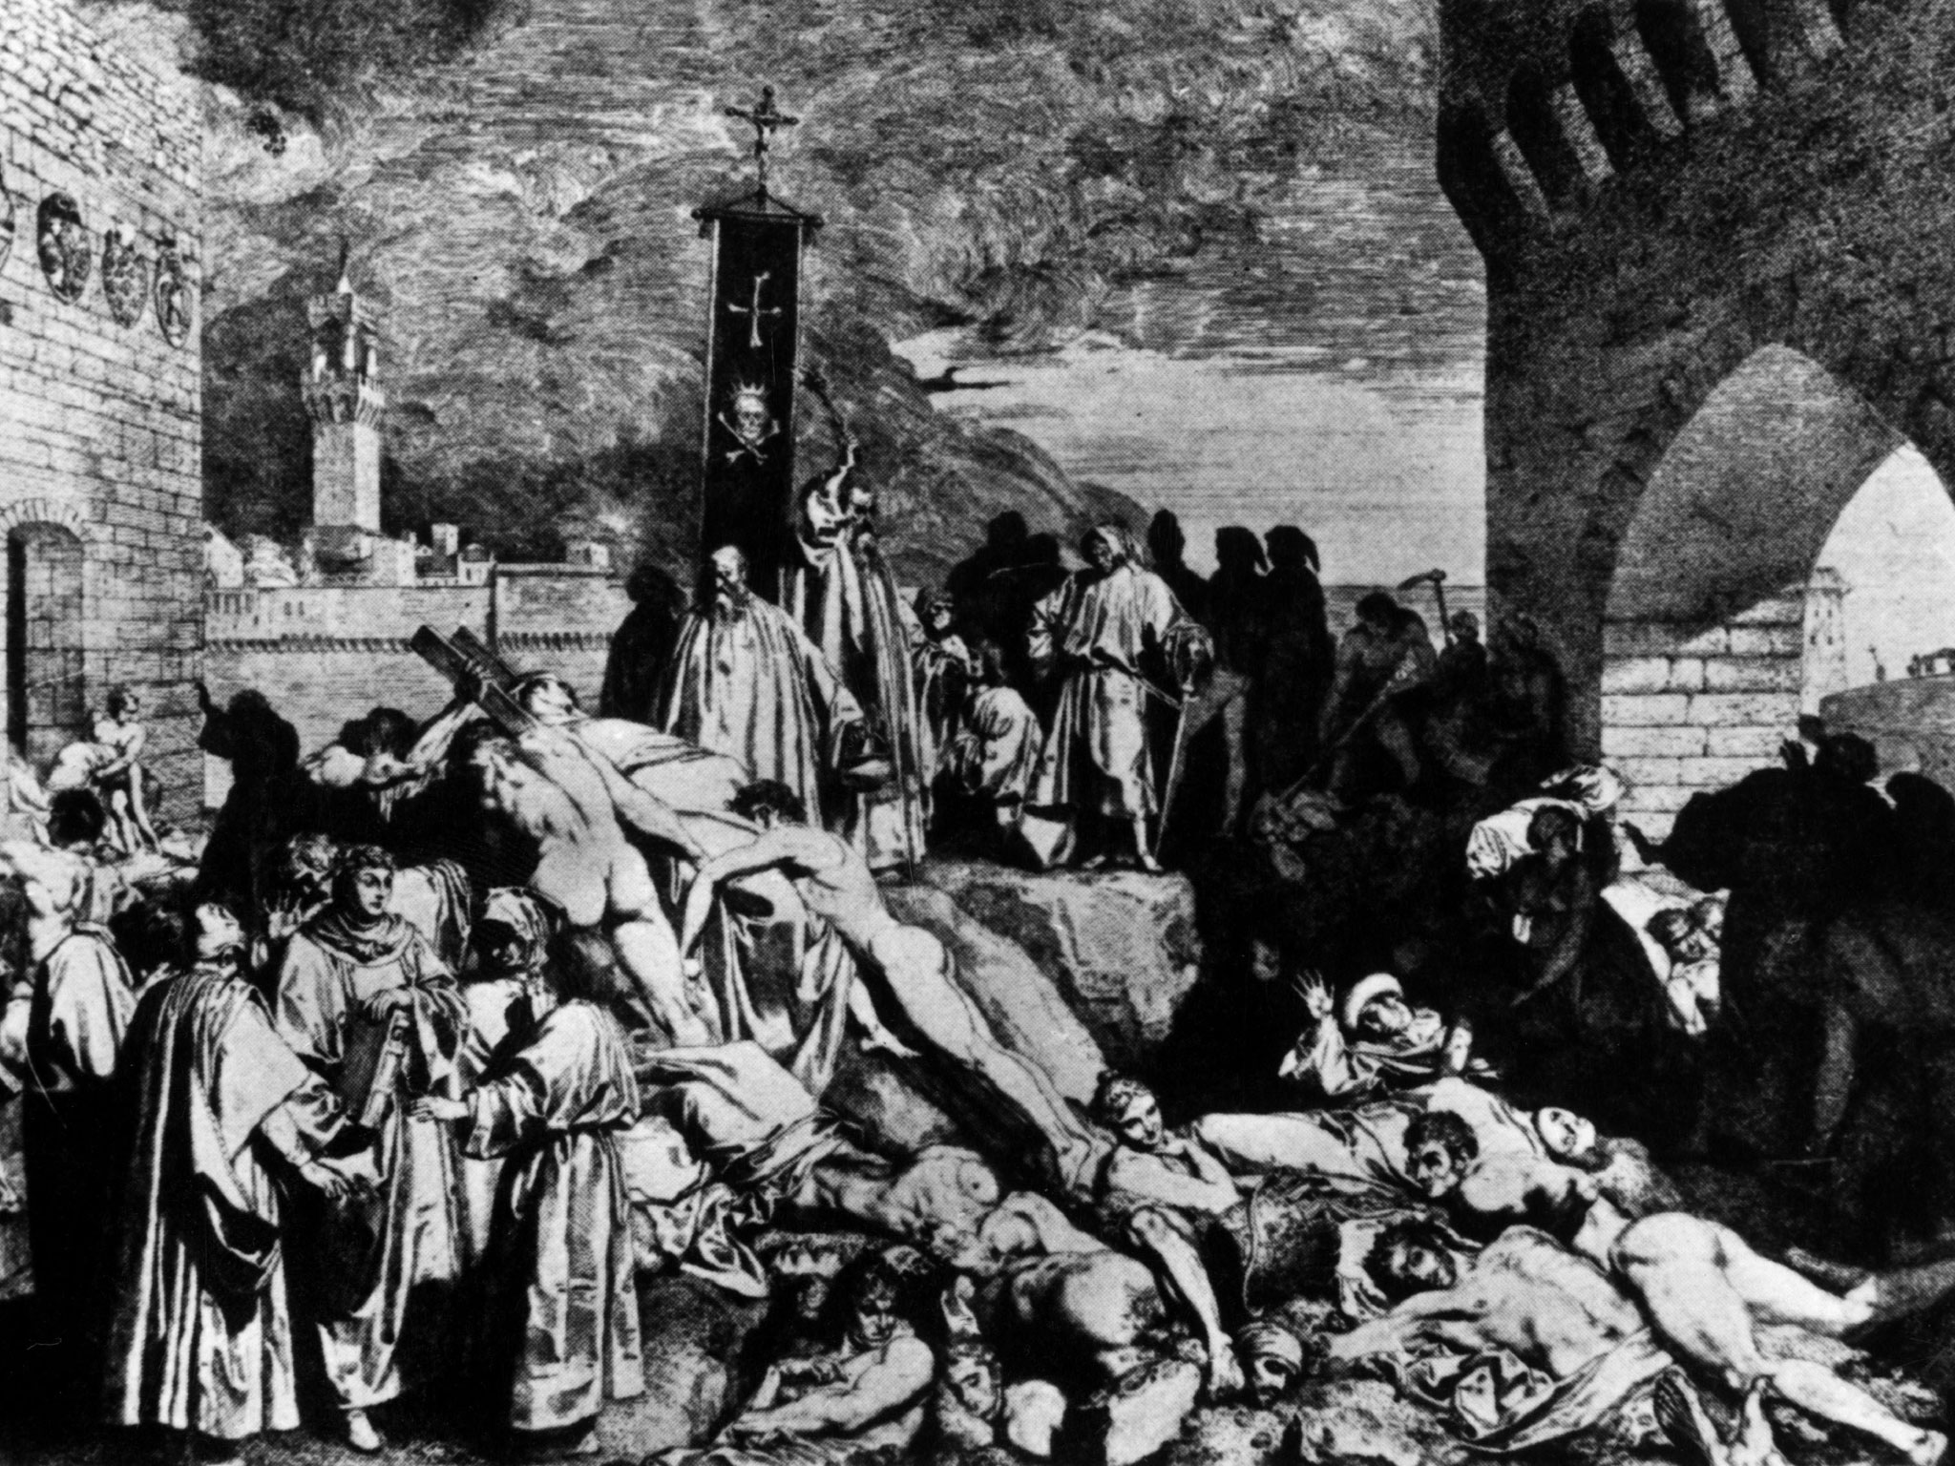
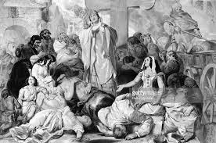
Bubonic Plague in Europe (1347 to 1348)
The Bubonic Plague originated from Ancient China and made its way to Europe via the Silk Road, the major trade road that connected Europe and Africa to luxuries that were rich to Asia and China.
The plague was carried across by rodents with infected fleas on their bodies.
The plague killed one out of three europeans, and infected livestock, creating a food and wool shortage.
This relates to AP themes #1 and #5, primarily disease and the development and transformation of social structures, because the plague created a labor shortage and allowed the lower class and the surviving population to have improved labor wages and conditions.

Slide 7

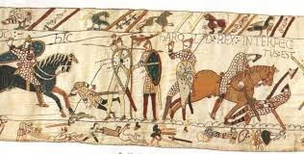
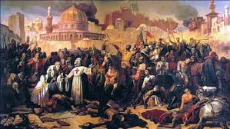
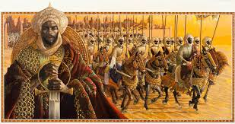
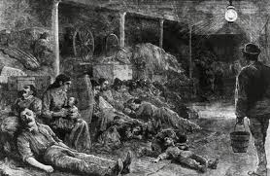
Conclusion
We began with the rise of Islam in around 632 CE because the expansion of the religion formed a sort of unity throughout the Middle East. The conquest of England created an expanse and more wealth for Europe. The european Christians, led by Pope Urban II, fought the muslims of the Middle East for the holy land of Jerusalem. Mansa Musa’s hajj showed a rise in the wealth of African trade and Islamic power. The Afro-Eurasian trade routes then led to the Bubonic plague, killing tons of people in Europe leading to a new revitalization.

